Slide 1
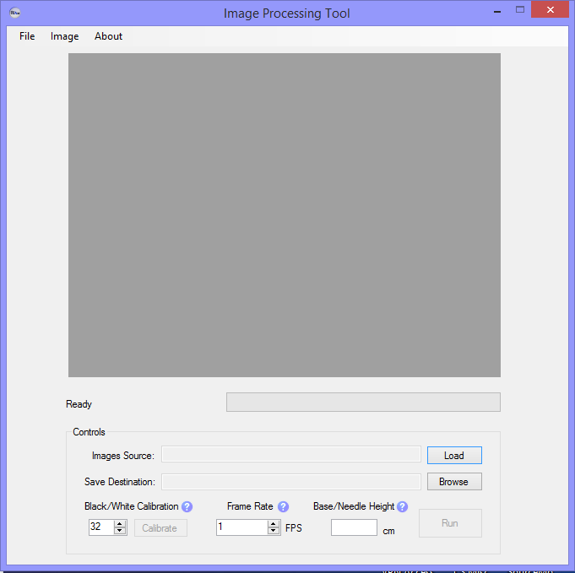
Demonstration
Load Images
Name Output File
Calibrate Processed Image
Run data set
Enter frames per second
Enter distance between base/needle if known
Notes:
Then actually demo – use data set that required sensitive calibration.

Slide 2

Proof in the Results

Slide 3
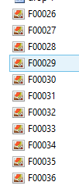

Test Report – Unsatisfied Requirements
Efficiency may not be improved
Processing time up to 2.5x longer vs Version 1.0
From ~1 min to ~2 min
But more robust, accurate
Excel table lacks the “frame number”
Notes:
Test Report – known problems; deviations from reqs

Slide 4

Test Report – Satisfied Requirements
Tracks the location of drop by following centroid
Determines location of needle/base automatically – able to fine tune
Does not require base image
Obtains volume and all required kinematics
Outputs to Excel
Generates plots as a function of time
Is Repeatable –successful for 3+ experimental sequences

Slide 5
Test Report – Satisfied Requirements Cont’d
Removes white center in drop
Provides accurate calculations

Slide 6


Test Report – Known problems
Run – Stop – Run again sequence may interrupt thread processes – cause crash
Similar issue with Exiting Tool during IO
Base/Needle height may not be measured accurately, will affect results

Slide 7
Hypothetical – Anne
What if we had more time?
Improve processing time, design of interface (change color scheme of form, more feedback from tool), ensure customer satisfaction
What if we could start over?
Start coding sooner
Plan/work on more defined, divided goals/milestones
Interact more with customer
What I learned
Image processing/manipulation through C#
Software Engineering Documentation
Team work/brainstorming

